Slide 1
IMS - Project
Kya Edmeade

Slide 2
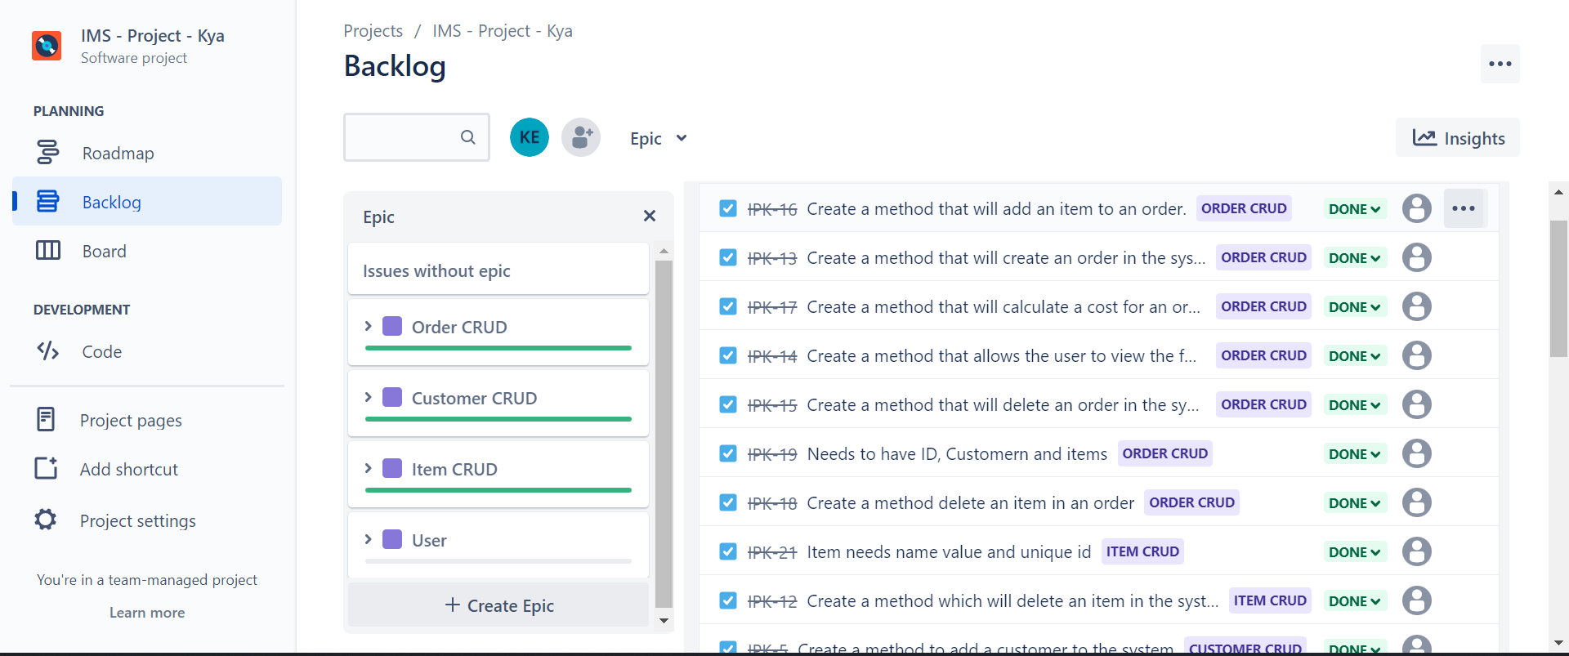
Jira Planning

Slide 3
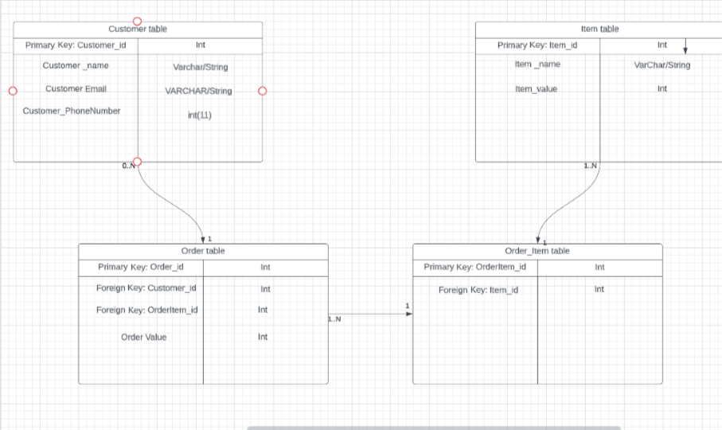
ERD

Slide 4
Risk Assessment
 | Description | Evaluation | Likelihood 1-not likely 5- very likely | Impact Level 1 – smallest impact 5 – massive impact | Responsibility | Response | Control Measures
1 | Computer Crashes | Unsaved work gets lost | 3 | 5 | HP | Start work again | Save work frequently
2 | Overheat in the heatwave | Work could be produced to a low standard, or I could get sick | 4 | 3 | Mine | Pick up missed work on the following days | Use a fan Drink lots of water
3 | Wifi goes down | Stops me from uploading to github and presenting | 4 | 2 | Virgin media | Use Hotspot to contact someone or upload the work | Make sure phone has data
4 | Personal Problems | Family emergency stops me from working | 2 | 5 | N/A | Inform a colleague | N/A
5 | Computer virus | Corrupts data | 2 | 5 | Anti-Virus protection | Try to recover work | Avoid suspicious emails and content
6 | Time management issues | Not allowing me to finish work | 3 | 2 | Mine | Present what I have | Plan work using Jira
7 | GitHub crashes | Lose all of the work | 1 | 3 | GitHub | Retrieve work from computer | N/A
8 | Misunderstood the task | Produce the wrong work | 1 | 5 | Mine | Redo the work at a later date | Read through brief and listen to trainers

